Slide 1








Slide 2
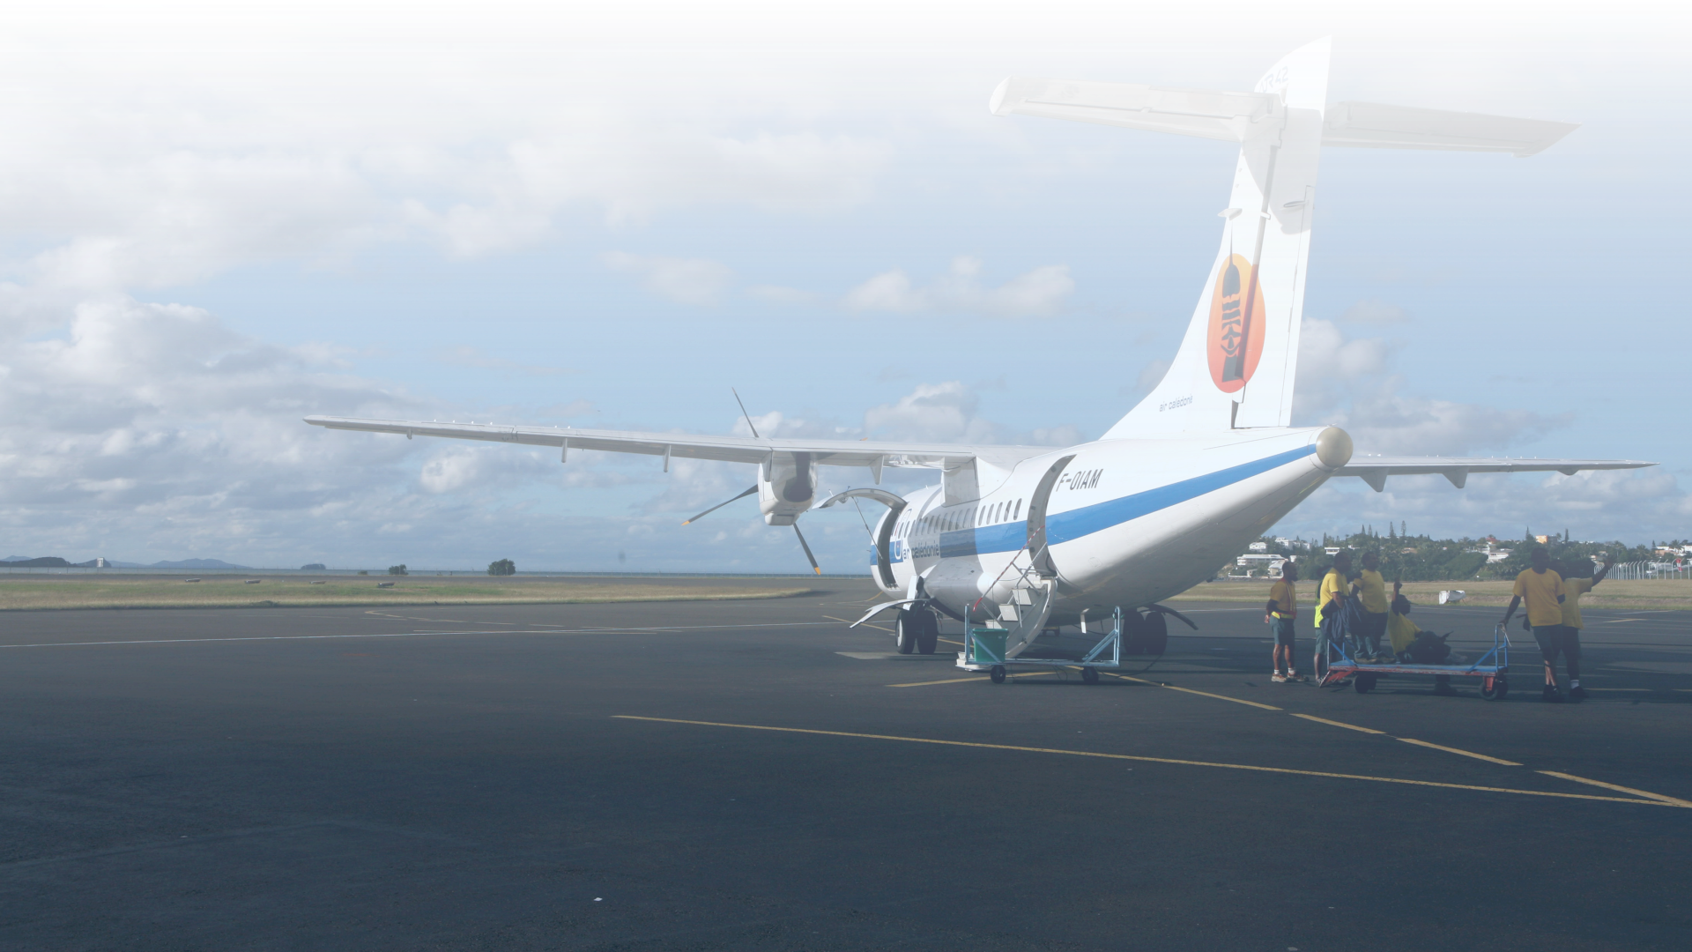











01. Introduction
Help the airlines in improving customer satisfaction and their overall performance

Slide 3
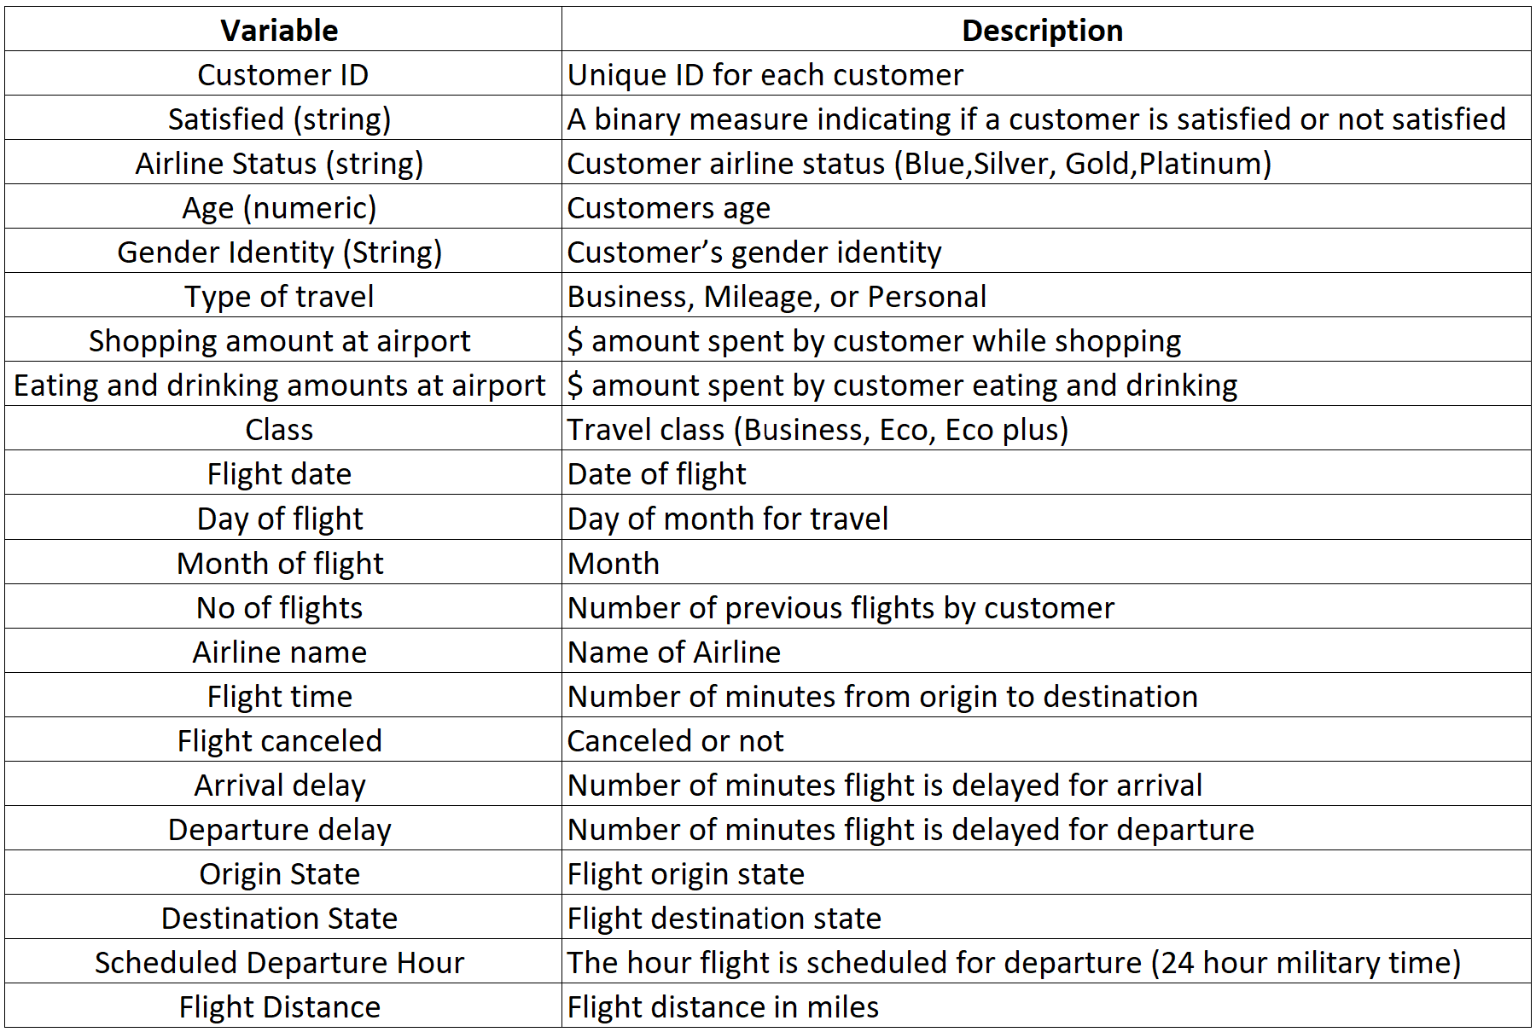
Data dictionary

Slide 4
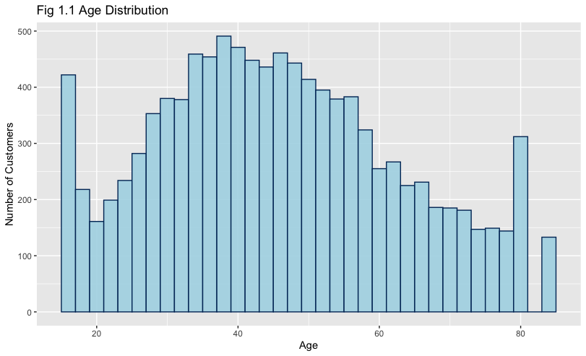

02. EDA
The most frequent flyers were 35-45
Most frequent flyers : 35 - 45 years old followed by ones of 45 to 60 years
15-17 years old and 75-80 years old flyers are pretty high

Slide 5
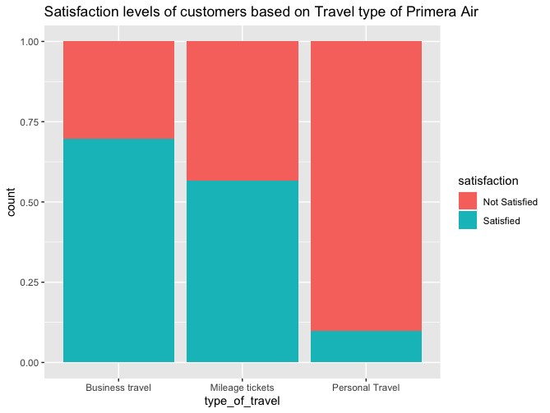
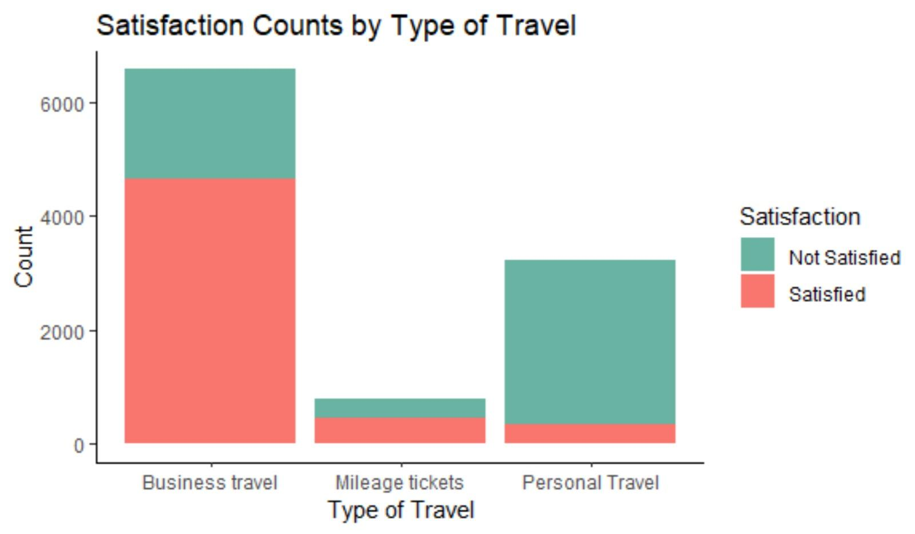

02. EDA
Personal > Business > Mileage
Business travel type had highest satisfaction level
Because of the airline? >> No

Slide 6
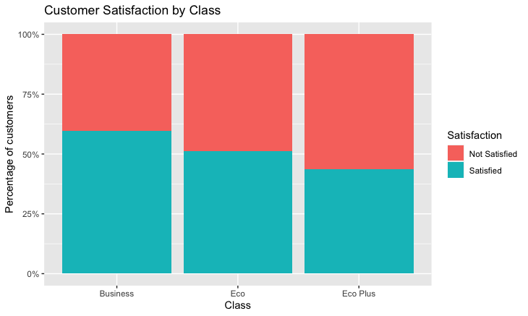
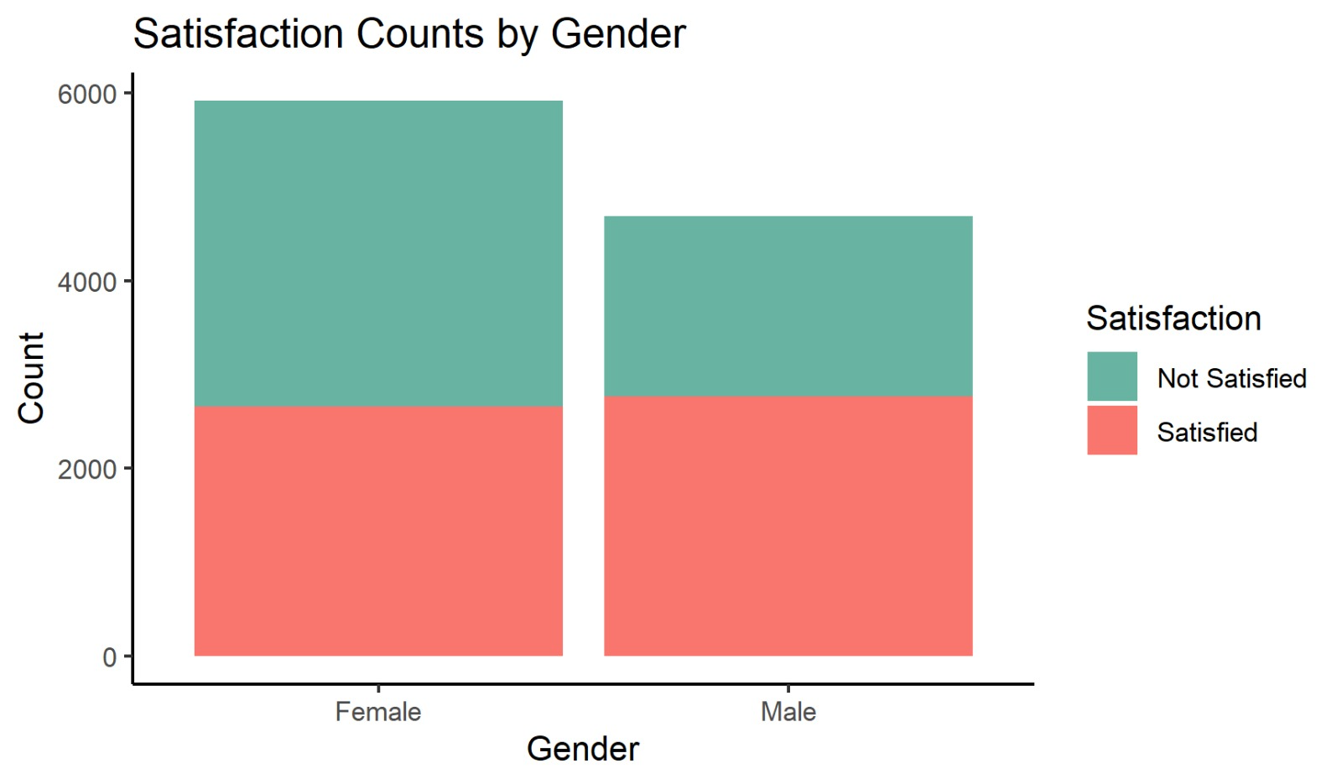
02. EDA
Business > Eco > Eco Plus
Male > Female
Business : 60% satisfied
Male’s satisfaction level is higher than females
Economy : 55% satisfied

Slide 7
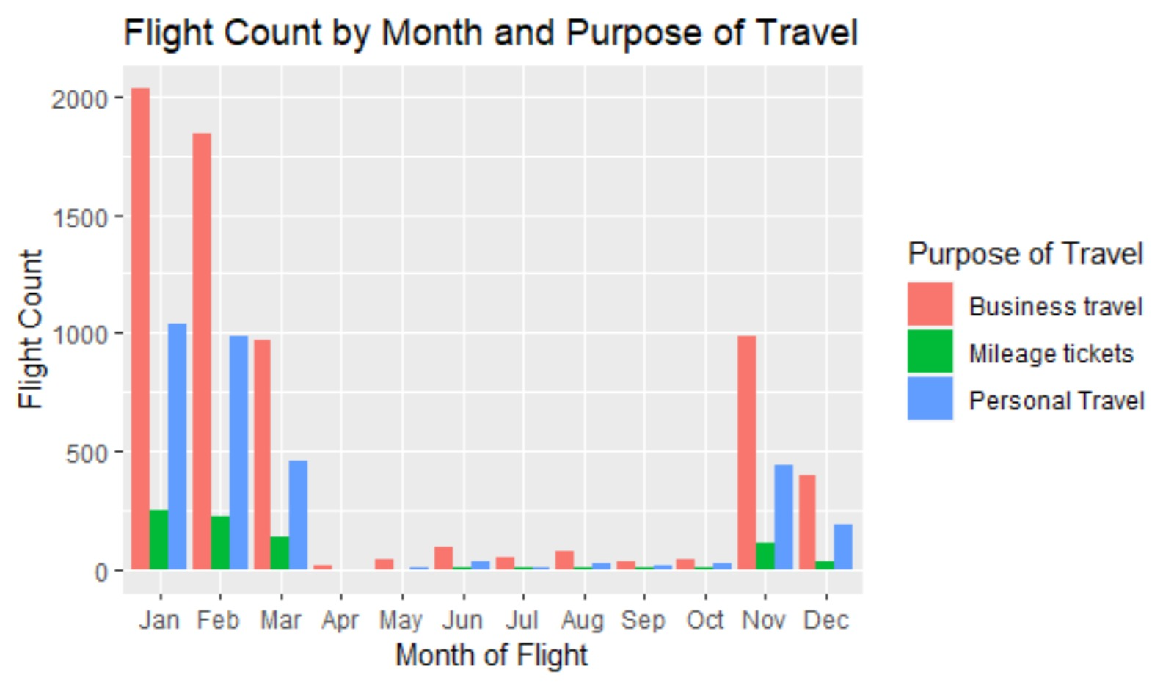
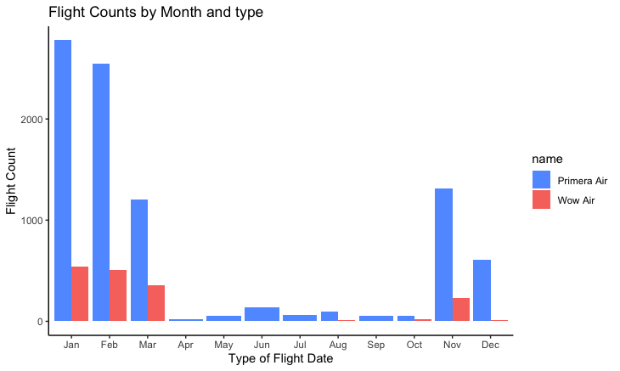
02. EDA
Monthly flight numbers by purpose
Monthly flight numbers by airline
Most number of flyers in the 1st quarter of year followed by end of the year.
Primera Air > Wow Air

Slide 8
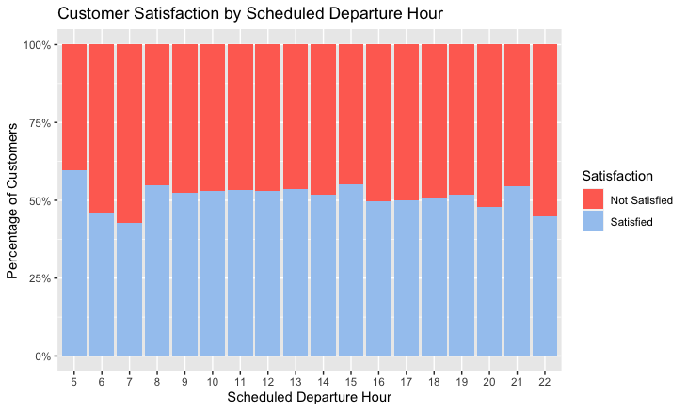
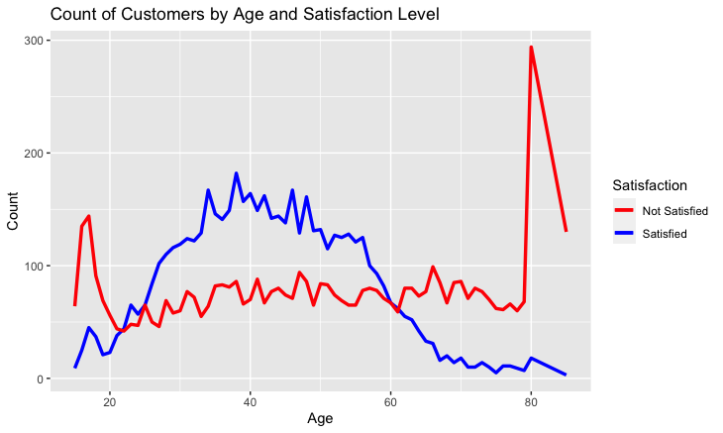
02. EDA
Departure time affects the satisfaction
Satisfaction level by age
Morning(6-7am) ↓
25-55 were most satisfied group
Late night(8-10pm) ↓
Elder flyers(60+) least satisfied group

Slide 9

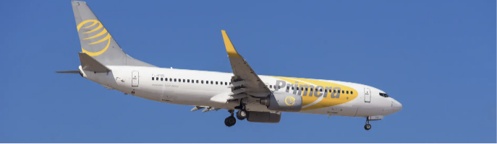

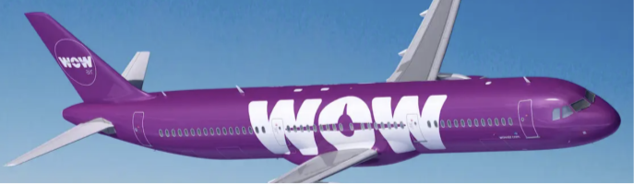
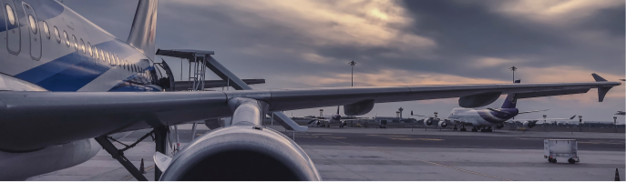
02. EDA
Primera Air is more popular
Most of the people travel through by Primera Air over Wow Air
Relationships among some variables
Satisfaction and some variables (females, teeagers, personal travel etc.) related closely
Further analytics will be processed
Will use regression model to analyze more details

Slide 10
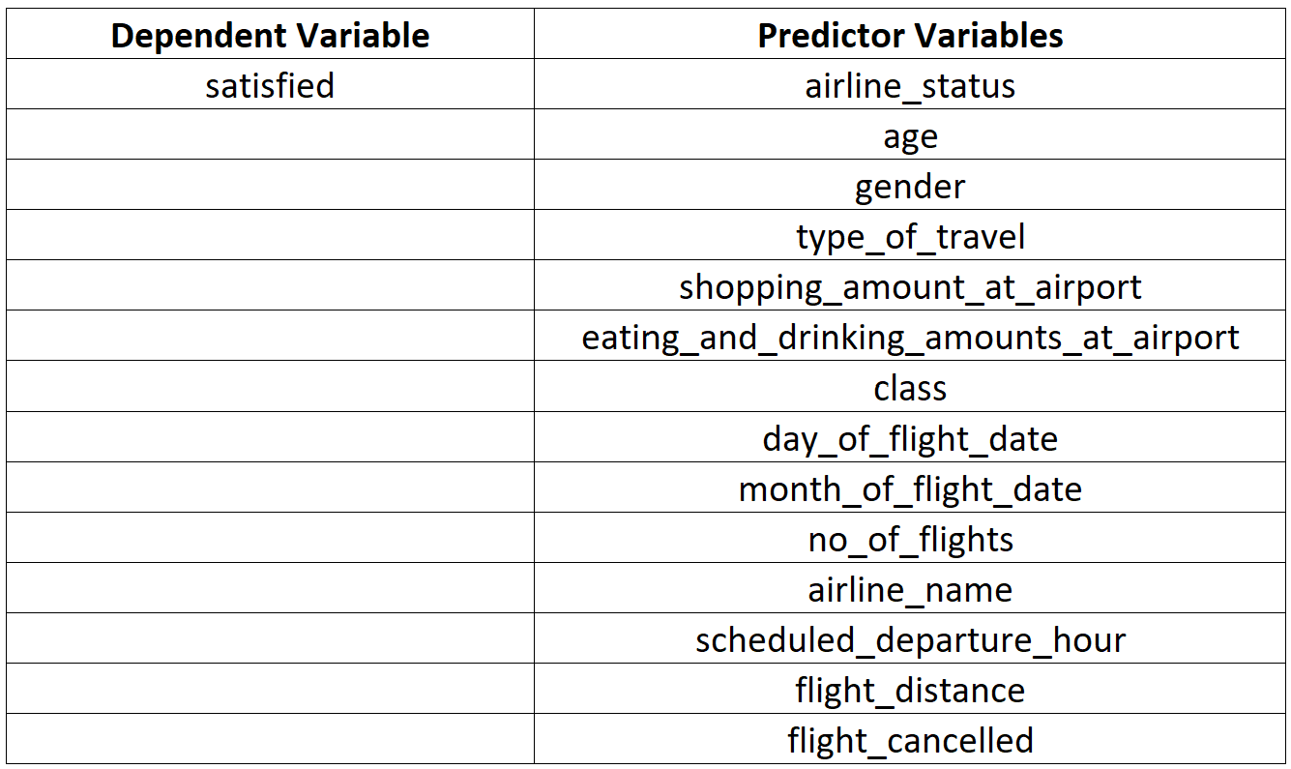
03. Analysis
Using Logistic Regression

Slide 11
01
01
393/ 418 records with missing values ~ cancelled flights
Check whether cancellation was a reason for dissatisfaction
Drop missing values
(flight_time, arrival_delay, and departure_delay)
393/ 418 records with missing values ~ cancelled flights
Check whether cancellation was a reason for dissatisfaction
Drop missing values
(flight_time, arrival_delay, and departure_delay)
02
Check the correlation
03
Split data into training and test data
04
Find out the statistically significant variables
05
Rerun the model with statistically significant variables
06
Test for an overall effect of categorical variables
07
Make predictions using the threshold of 0.5

Slide 12
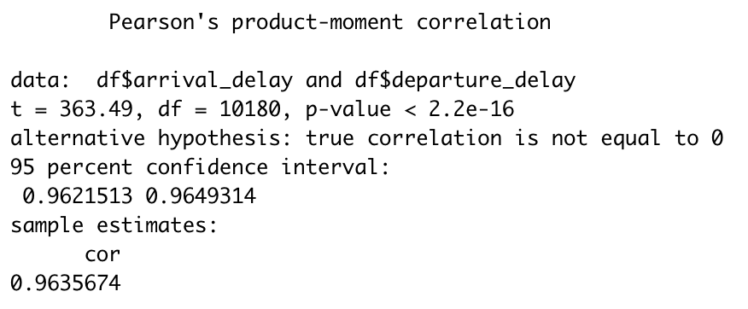
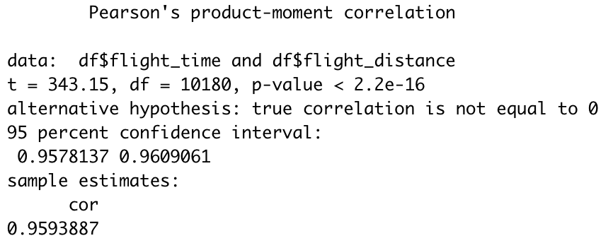
01
Drop missing values
(flight_time, arrival_delay, and departure_delay)
02
Check the correlation
Table 1: Pearson’s correlations between arrival_delay and departure_delay
03
Split data into training and test data
04
Find out the statistically significant variables
05
Rerun the model with statistically significant variables
Table 2: Pearson’s correlations between flight_time and flight_distance
06
Test for an overall effect of categorical variables
07
Make predictions using the threshold of 0.5

Slide 13
01
Drop missing values
(flight_time, arrival_delay, and departure_delay)
02
Check the correlation
03
Split data into training and test data
04
Find out the statistically significant variables
05
Rerun the model with statistically significant variables
06
Test for an overall effect of categorical variables
07
Make predictions using the threshold of 0.5

Slide 14
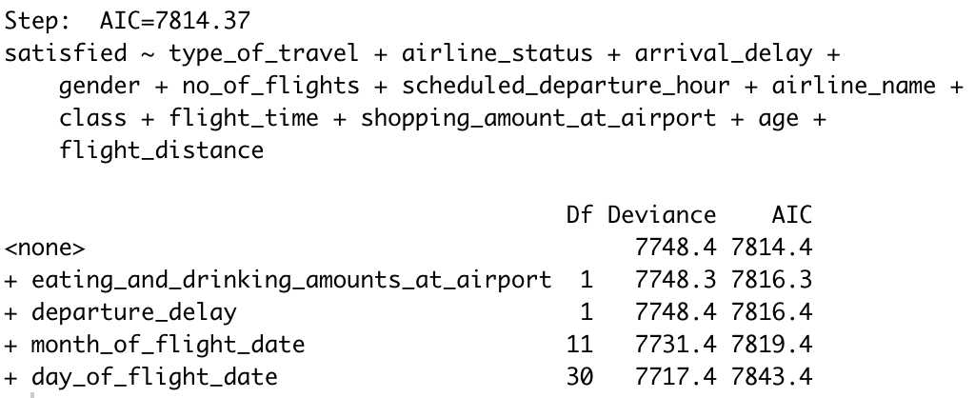
01
Drop missing values
(flight_time, arrival_delay, and departure_delay)
02
Check the correlation
03
Split data into training and test data
04
Find out the statistically significant variables
Table 3: Forward Stepwise Regression
05
Rerun the model with statistically significant variables
06
Test for an overall effect of categorical variables
07
Make predictions using the threshold of 0.5

Slide 15
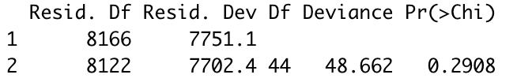
01
Drop missing values
(flight_time, arrival_delay, and departure_delay)
02
Check the correlation
03
Split data into training and test data
04
Find out the statistically significant variables
05
Rerun the model with statistically significant variables
Table 4: Analysis of Deviance Table
06
Test for an overall effect of categorical variables
→ The latter fitted as well as the previous model.
07
Make predictions using the threshold of 0.5

Slide 16
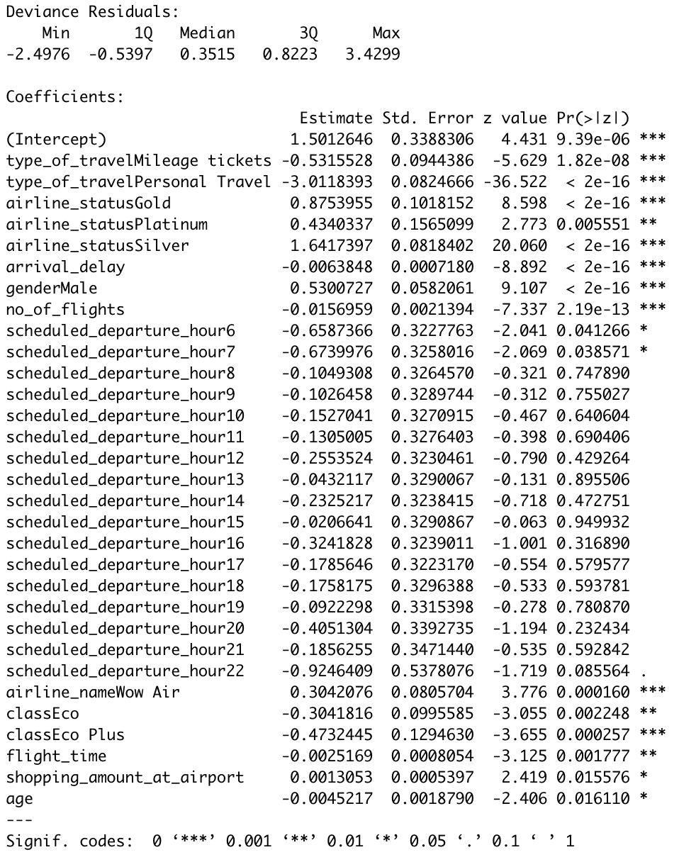
01
Drop missing values
(flight_time, arrival_delay, and departure_delay)
Table 5: Model result
02
Check the correlation
03
Split data into training and test data
04
Find out the statistically significant variables
05
Rerun the model with statistically significant variables
06
Test for an overall effect of categorical variables
07
Make predictions using the threshold of 0.5
p_value < 0.05 → statistically significant.

Slide 17
01
Drop missing values
(flight_time, arrival_delay, and departure_delay)
02
Check the correlation
03
Split data into training and test data
Final model:
satisfied ~ type_of_travel + airline_status + arrival_delay
+ gender + no_of_flights + scheduled_departure_hour + airline_name + class + flight_time + shopping_amount_at_airport + age
04
Find out the statistically significant variables
05
Rerun the model with statistically significant variables
06
Test for an overall effect of categorical variables
07
Make predictions using the threshold of 0.5

Slide 18
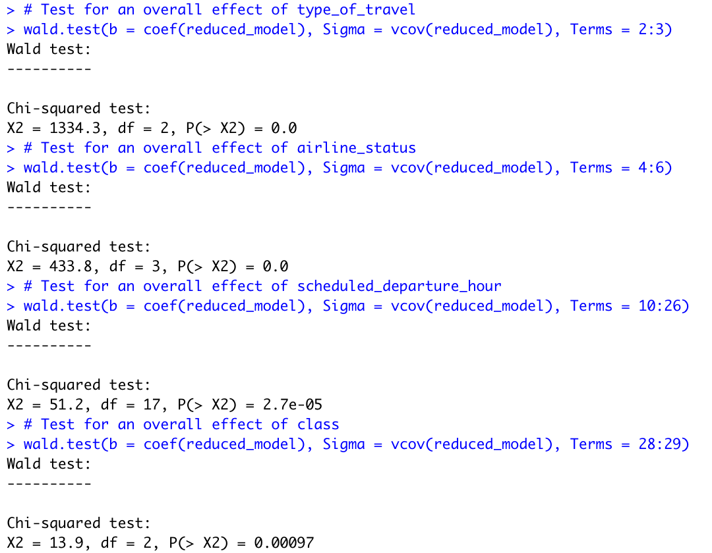
01
Drop missing values
(flight_time, arrival_delay, and departure_delay)
02
Check the correlation
Table 8: Wald test for the overall effects of each variable
03
Split data into training and test data
04
Find out the statistically significant variables
05
Rerun the model with statistically significant variables
06
Test for an overall effect of categorical variables
07
Make predictions using the threshold of 0.5

Slide 19
01
Drop missing values
(flight_time, arrival_delay, and departure_delay)
02
Check the correlation
03
Split data into training and test data
04
Find out the statistically significant variables
05
Rerun the model with statistically significant variables
06
Test for an overall effect of categorical variables
07
Make predictions
Calculate the probabilities of satisfaction on test data
Labeled as satisfied (value of 1) using the threshold of 0.5

Slide 20
03. Analysis
Evaluate the model
The accuracy of the model reached 76.86%.
AUC (the area under the curve of ROC) equaled 0.8264428.
Specificity equaled 0.6571.

Slide 21
04. Conclusions and Recommendation
Additional services for the older customers
Offer additional benefits to economy plus
Provide them with better facilities - Free wheelchair
Early check-in and boarding for these customers.
Economy plus flyers were the most unsatisfied class.
Additional services for the younger customers
On-time arrival & departure of flight
Better amenities like access to the lounge with a separate kids section & Provide them with priority boarding and checking in like for older customers
Offering on-time arrival & departure would be helpful to increase satisfaction level for all classes
Additional services for female
Differential pricing to the various age groups
Added benefits like providing free hygiene kits when necessary.
should offer differential pricing to the various age groups, leading to more sales and satisfaction (price reduction for infants and senior citizens)
Loyalty programs based on classes
Roll out more loyalty programs based on classes (Blue,Platinum,Gold and silver). All classes had a positive relation to the regressor(satisfaction)

Slide 22






